Slide 1
TRAINING ON THE REVISED GENERIC INTERVENTION PROCESS FORMS - ADMINISTRATIVE TOOLS
IMPLEMENTATION OF THE GIP
29 – 30 MARCH 2021

Slide 2
Background to the process and overview of the tools
WHY:
Improve quality of service delivery
Improve reporting and planning
Provide guidelines to implementers – SSPs
Strengthen supervision
Through streamlined administrative systems

Slide 3
Rationale of the project
The development of an administrative system emanated from the need for a consistent approach to documentation of social welfare services delivered
The White Paper also identified information management as a gap in the effective delivery of social welfare services
In response, various information systems / modules have been developed, but are loose standing / silo’s (e.g. CPR, CBIMS etc.)
Various data collection tools have also been developed – especially for means of verification purposes – but these are not integrated and standardised across provinces
The focus of this project is on generic processes – programme specific interventions / tools etc. will still apply

Slide 4
Objectives of project
To standardise administrative practices across the sector
To improve information management processes
To improve reporting on core services rendered (problems reported vs. interventions)
To provide guidance on selection of the appropriate tool(s) to be utilised
To improve utilisation of theory and increase reflection
To inform social welfare policy formulation, planning and monitoring

Slide 5
Conceptual Framework
Developmental Approach
WP for Welfare (1997)
Socio-economic challenges
ISDM
FSWS
Collaboration with sector partners
3 broad programmes
Roles and responsibilities
Primary and secondary practice environments
Nature, scope, extent and level of services
Target groups
Constitutional mandate

Slide 6
CONCEPTUAL FRAMEWORK ….
The Integrated Service Delivery Model indicating the nature, scope, extent and level at which services are rendered – see Figure 1
The Framework for Social Welfare Services (2013) unpacks services to beneficiaries in terms of strategic focus areas, basket of services, levels and systems of intervention, life stages and generic intervention processes – See Figure 2
The Generic Intervention Processes documents business processes, which are a collection of related / structured activities that produce a specific output for the service beneficiary – see Figure 3

Slide 7
INTEGRATED SERVICE DELIVERY MODEL
Figure 1
Social welfare services
Client Groups:
Poorest of the poor
Marginalised
Vulnerable
Social Security
Community Development

Slide 8
INTEGRATED SERVICE DELIVERY
Social Security
Development:
-Skills
Development
-Food
Production
-Income
generating
projects
E X I T
Point of Entry
Beneficiary + Community
Profiling
Assessment by Social Service Professionals
Social
Services
Monitoring and Evaluation

Slide 9
FRAMEWORK FOR SWS
GOAL
To facilitate/guide the implementation of a comprehensive, integrated, rights-based, well-resourced, and quality developmental social welfare services.
To be achieved through these objectives

Slide 10
OBJECTIVES OF THE FSWS
Provide a theoretical framework and approach for social welfare services
Describe the collaborative partnerships essential for social welfare services.
Define the practice environment/context for the delivery of integrated social welfare services.
Describe integration of developmental social welfare services in terms of the following:
Identify vulnerable target groups and strategic focus within the life cycle.
Describe the enabling factors for integrated social welfare services.
Provide mechanisms for the promotion of quality social welfare services,

Slide 11
FIGURE 2 FSWS

Slide 12
GENERIC INTERVENTION PROCESSES
a. Rationale for GIP
Promote service integration.
Ensure appropriate practitioners perform as expected.
Improve professional recording, filling and document management.
Advocate for allocation of appropriate service enablers.
b. Management activities
District level training of implementers, supervisors and managers.
Development of Guidelines.
Provision of SWS forms.
Monitoring of implementation

Slide 13
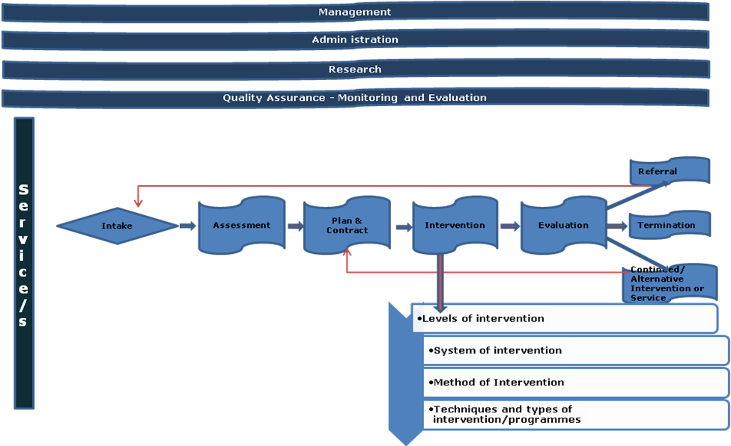
Figure 3 - GIP

Slide 14
IMPLEMENTATION MONITORING
IN ALL PROVINCES
Monitor compliance.
Analyse the gaps.
Assess level of improvement in application of the generic intervention processes.
Determine organisational factors impacting on compliance.
Provide support.

Slide 15
FILE CHECK
Objectives:
To check whether files are opened and maintain the required standard in terms of correct filing system, file cover and indexing.
To monitor adherence to the prescribed process flow.
To check the correct completion of process forms.
Correct filing of supporting forms.
Whether supervision is being carried out, and
Appropriate practitioner carrying out the process.

Slide 16
GENERAL FINDINGS: IMPLEMENTATION OF GIP
Sporadic application of the process forms
Limited records of process notes on assessment. SWS05 is evidenced in some files - more of a “filling in the missing words”. No multiple sources of information, however, on psychosocial reports there are more than one source of information. Officials indicated that the circumstances in their offices does not warrant the application of the process. They share offices as a result they do not have suitable space to utilise for effective assessment. Other officials have to move out when they engage with clients. Professional principles are compromised.
Does intervention address the needs of service users?

Slide 17
REMEDIAL ACTION PLANS
Continuous training of practitioners
Promote adherence to the process flow – value chain
Utilisation of all the process forms SWS01-11
Provincial monitoring visits
Strengthening of supervision.
Management support – adequate allocation of resources and tools of trade

Slide 18
REVISED ADMINISTRATIVE TOOLS

Slide 19
Revised administrative systems
Overview of the revised tools
Case work tools
Group work tools
Community work tools
Reporting tools
Screening registry
Intake registry
Central registry
Monthly reporting tool

Slide 20
Screening Process
Activities
Obtain client information and complete applicable tools
Conduct screening interview
Refer to intake service or to external organisation
Control documents
Screening register 01
Reporter Form CW02
Identifying Information CW03
External Referral formCW04b

Slide 21
Intake Process
Activities
Conduct intake interview
Complete intake form and process report
Capture and file intake form and report
Control documents
Screening Register CW 01
Identifying Information CW03
Reporter Form CW02
Intake form CW05
External Referral CW04b
Intake Register

Slide 22
Assessment Process
Activities
Receive referral
Schedule appointment if not yet done
Conduct assessment interviews in order to identify need for service
Complete section 1 and 2 of the assessment, planning and contracting form based on the findings of assessment, Agree with the client on the time and place for the meeting to develop the plan.
Admin tools
Referral note CW04b
Assessment, planning and contracting form CW09
Process Note CW11

Slide 23
Intervention Process
Professional behaviour of SSP to
Facilitate change in the person-environment- situation in order to achieve the objectives as stated in the agreement/ contract entered into by the beneficiary and SSP
NB!!! Interventions and sessions
Intervention can be through any of the ff systems
Individuals, families, couples, groups, communities

Slide 24
Evaluation Process
Activities
Review objectives of initial plan by reviewing process notes and consultation with client
Review progress and achievement of objectives by retrospection in collaboration with client.
Jointly decide the best way forward, being one of the following:- Continued Intervention/ Alternative intervention/ Referral or Termination
Complete and file evaluation report accordingly
Capture process note
Control documents
Process notes CW11
Evaluation Report CW 12

Slide 25
Termination
Activities
Discuss the final evaluation with the client
Conduct the final termination session
Compile a case closure report
Capture and file case closure report
Submit for sign off by supervisor
Submit file for archiving
Control documents
Process Note CW11
Termination report CW13

Slide 26
Administrative tools SOP

Slide 27
GROUP WORK AND APPLICABLE TOOLS

Slide 28
GROUP PROCESSES
Planning and Orientation
Group selection & Contact making Identification of the needs and challenges of individual members, group formation
b. Contract making
Commitment by group members (agreement and rules)
c. Implementation
Action phase:- Discussion themes/topics; Facilitate the group sessions .Compile process notes, Conduct an evaluation after each session highlighting the effectiveness of each session’s activities.
d. Evaluation: continue, terminate.
Control Documents & Tools
Proposal to establish the group
Contracting
Process notes
Evaluation report
Agenda in treatment groups – written and unwritten
Agendas in task group
Attendance registers
Termination report

Slide 29
Objectives in the Beginning Stage
Introducing members
Clarify purpose and function of the group as perceived by members, worker, and the agency
Discuss the limits of confidentiality
Help members feel they are a part of the group
Notes:
Guide the development of the group
Balance task and socio-emotional aspects of group processes
Set goals
Contract for work
Facilitate members’ motivation and ability to work
Address ambivalence and resistance
Work with mandated clients
Anticipate obstacles to achieving individual and member goals

Slide 30
Involving Members
Involve members in developing the purpose and goals - also in decision making
Empathic sharing and responding
Reach out for members feelings
Encourage ventilating
Commonalities
Make connections
Notes:
Mutual aid

Slide 31
Ethical consideration
Confidentiality
Member agreement
Reminders about confidentiality
Limits of confidentiality

Slide 32
Group Evaluation
Beginning phase
Pre-test based (expectations)
Rate functioning at the beginning of the group
Mid-session evaluation
The leader request members to provide feedback on the group thus far and the changes they feel need to occur to make future sessions more useful.
Outcome evaluation
Measures the level of individual change that occurred by being part of the group.
Members satisfaction questionnaire.

Slide 33
GROUP WORK TOOLS

Slide 34
COMMUNITY WORK AND APPLICABLE TOOLS

Slide 35
COMMUNITY WORK
Activities
Get to know the community
Obtain demographic information e.g. population, services, trends, target groups
Determine community resources(assets)- Physical, social, financial, natural
Identify key community role players
Capture/ file community profile report
Control documents
Community profile report
Minutes of meetings
Process reports
Evaluation report

Slide 36
PLANNING
Exploring a range of alternative solutions to identified problems; thinking more about
fundamental causes of the problem
community goals and projects to achieve them
involvement of community members and task teams
Empowerment and benefits to community
Activities
Establish a task team from the community
Confirm identified needs as per needs assessment in com profiling
Develop a business plan with objectives, (linked to identified goal) budget, & other resources required, role players and timelines (duration and frequency)
Agree on the plan with community representatives
Submit and request approval for the plan

Slide 37
IMPLEMENTATION
Programmes and projects
NB!!! Duration & frequency
as stated in the plan
record activities/ contacts made

Slide 38
PROGRAMME EVALUATION
Implementation of the plan through various sessions/ contacts (process notes)
Activities
Review objectives of initial plan by reviewing initial plan with participants
Review progress and achievement of objectives by retrospection in collaboration with participants
Plan the follow up actions with participants
Complete and file programme evaluation report accordingly
Capture process note
Control documents
Business plan Process Note
Programme evaluation report
File closure report

Slide 39
Options
Continuation
Alternative
Termination

Slide 40
COMMUNITY WORK TOOLS

Slide 41
Reporting

Slide 42
WAY FORWARD AND CLOSURE

Slide 43
IMPLEMENTATION
Preparatory phase
Introduce new forms to officials at your various offices by ………………… (Coordinator to develop a revised implementation plan chairperson of the forum).
Regional management and provincial programme managers and provincial coordinator to support districts
Regional Reps support each other amongst regions to in-service Social Worker and Social Auxiliary workers.
National support province with training of the remaining regions by end of ………………………………..
Implementation phase –
Implementation of new Administrative tools by all in the province (April 2021)
Monitoring and reporting
Monitoring and Evaluation of implementation by all.

Slide 44
TOT SIENS

